Slide 1
Technical Skill Workshop
Website Development

Slide 2
HTML and Tags ..
HTML is the basic mark-up language that is used to develop web pages.
Tags are similar to keywords in programming languages like Java.
Tags are used to code the content of web pages.

Slide 3
Structure of HTML document.
The structure of HTML document mainly consists of three tags – html, head and body.
Head and body tags are inside the html tag.

Slide 4
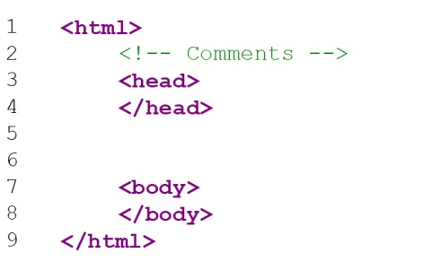

Slide 5
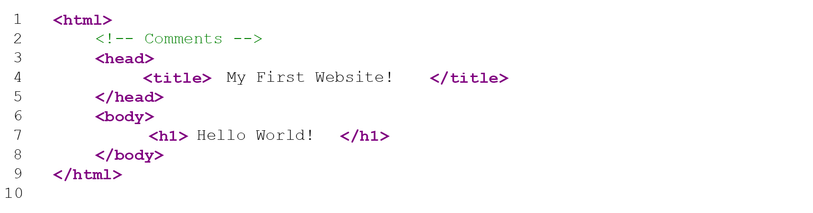
Your First Website
Open notepad.
Write the above code.
Save the file with extension .html
Open the file in Chrome or Internet Explorer to view.

Slide 6
Introduction to CSS
Use to style the web pages.

Slide 7
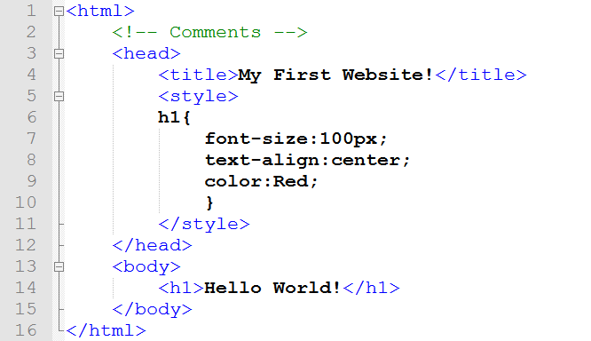
Styling HTML with Style Sheets ; Embedded

Slide 8
Inline, Embedded and External Style Sheets
Inside the tag.
Using style tag in the head of the HTML document
Separate document for CSS

Slide 9
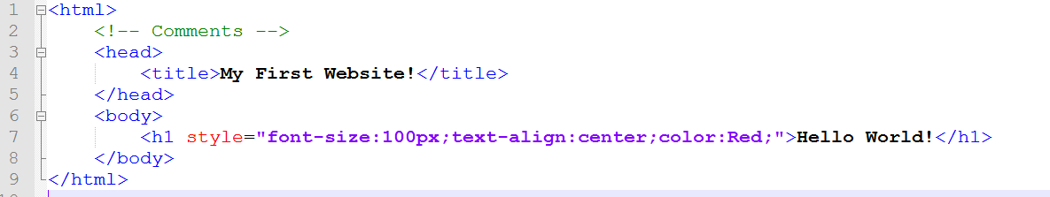
Inline : Inside the tag

Slide 10
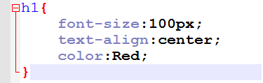
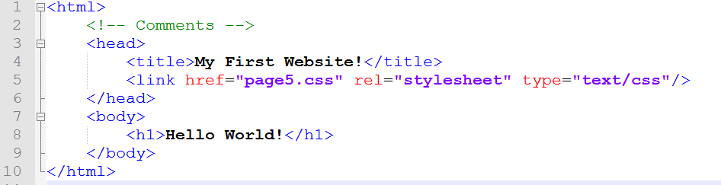
External : Linking CSS
Write this code in a separate .css file

Slide 11
Now lets make our own website !! ☺

Slide 12
Exercise 1
Building header using header and heading tags.
Styling header using CSS.

Slide 13
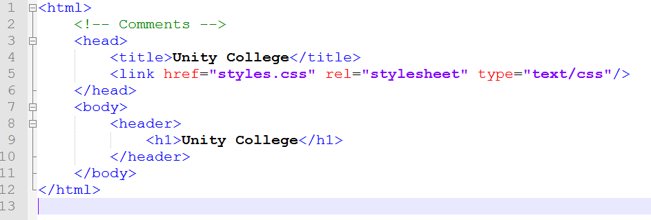
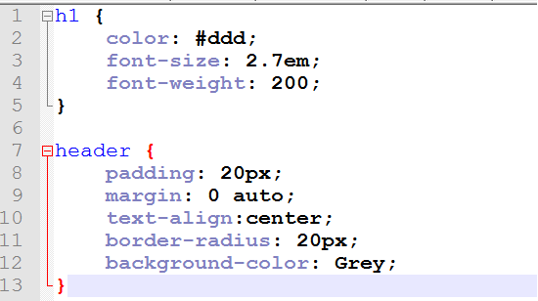

Slide 14
Exercise 2
Designing the overall outlook of the website using body.
Using different containers for header, page content.
Usage of div.

Slide 15
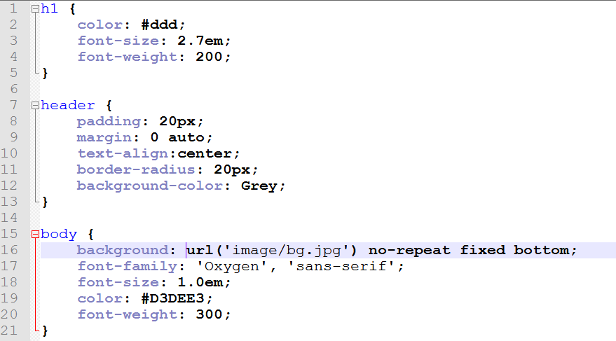
Change the CSS to style the body

Slide 16
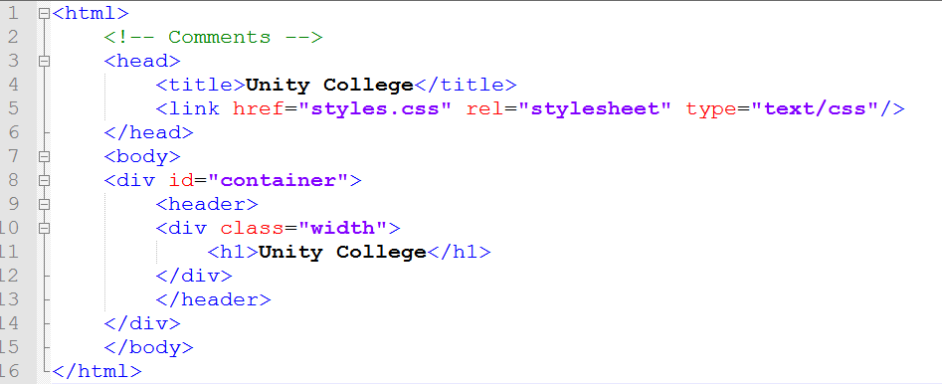
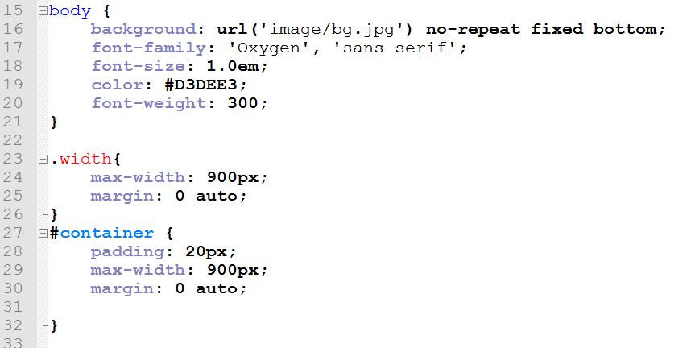

Slide 17
TS Workshop : WD
Continued….

Slide 18
Some Useful Tags
Anchor :
<a href=“URL”>DES</a>
Image :
<img alt=“DES” src=“URL” />
Table :
<table> .caption.th.tr.td..</table>
Listing :
<ul> <ol> <li> <dl> <dt> <dd>
Forms related :
<form name=“”> </form>
<select> <option> <textarea>
Frame :
<frameset cols=“,” rows=“,” >
<frame name=“” src=“”>

Slide 19
Some Useful Tags
Div:
<div></div>
Footer:
<footer></footer>
Navigation:
<nav></nav>
Section :
<section> </section>
Header:
<header></header>
Article:
<article></article>
Paragraph:
<p> </p>
Line Break :
<br />

Slide 20
Exercise 3
Adding nav-bar to the website using ul and li tags.
Corresponding CSS properties like display and list-style.

Slide 21
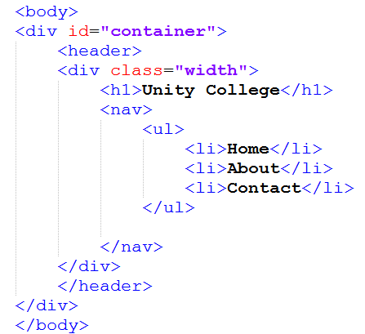
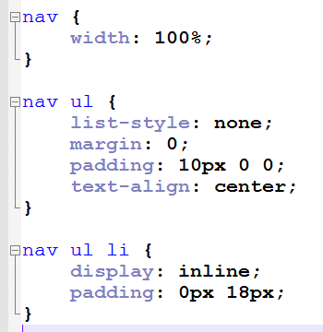

Slide 22
Exercise 4
Adding main content using paragraph tag

Slide 23
Exercise 5
Adding sidebar and positioning it relative to the main page content using CSS float property - Section and aside tags.

Slide 24
Exercise 6
Make “About” Page.
Link pages in the website by utilizing anchor tag (<a></a>).

Slide 25
Exercise 7
Make “Contact” Page.
Add a Table.
Add a contact Form.
Hyperlink up all.

Slide 26
Exercise 8
Adding footer and running the website to check whether everything is working.

Slide 27
Some topics
Website Publishing process
Domain name server
Web hosting

Slide 28
Internals
HTTP Browser Request and Server Response
HTTP headers
Proxies
URI and URLs
Using Xampp

Slide 29
Thank you all for joining!
We hope to see you again!

